Slide 1

Abed Al Rida Nehmeh
Mohammad Ghoush Roxane Mezher
Reina Al Hariri

Slide 2
I. 2. Relevance and Feasibility
Problem Statement:
Time is a crucial part of fighting wildfires, and inefficiency in extinguishing the fire can lead to the loss of lives and tons of biomass and risk of fire spreading into human property.

Slide 3
I. 2. Relevance and Feasibility
Proposed Solution:
The aim of this project is to develop a cheap, autonomous system that will help firefighters figure out the highest priority areas to extinguish in cascading bursts, increasing time-efficiency and saving lives and biomass and preventing the fire from spreading to human property.

Slide 4
I. 2. Relevance and Feasibility
Technical Feasibility, Drone Implementation:
A drone gives us an aerial view of the topology of the wildfire zone, which is the fastest and most reliable implementation to the proposed solution.

Slide 5
I. 2. Relevance and Feasibility
Resources Feasibility:
The drone we implemented includes widely available and standard educational equipment, which means that resources to build this drone are widely available and manufacturing won’t be an issue.

Slide 6
I. 2. Relevance and Feasibility
Financial Feasibility:
A drone is estimated to cost around 450$, covering an estimated 20km area, making it a viable solution compared to other technologies used in crisis aversion.

Slide 7
I. 2. Relevance and Feasibility
Future potential and Scalability:
The drone system is designed to be integrated with future developments in emergency response robotics, like human rescue rovers, making it highly potent in the future with features such as autonomous robotic control, traveling salesman implementation, and serving as a communication means in the crisis area.

Slide 8
II. Business Viability
Market Analysis:
The public sector and emergency agencies and NGOs such as Lebanese Red Cross will benefit from this system. There is no other system in the market that does what our system does, making it one of its kind, and extremely valuable for what it offers at its current price.

Slide 9
II. Business Viability
Business Model and Strategy:
At a sales profit of 35%, a complete drone system can be sold at 607$; in addition to that, maintenance fees will add up to the revenue.
Meanwhile, the marketing will be done through industry conferences and partnerships with humanitarian organizations.

Slide 10
III. Technical Details
System Architecture:
A quad copter controlled with Arduino MKR 1300 is equipped with a camera, receives controls from the station’s Arduino MKR 1300 and sends aerial images to the station’s Arduino via LoRa communication.

Slide 11
III. Technical Details
System Architecture:
Note that the quadcopter’s arduino is equipped with IR ultrasonic sensors for obstacle avoidance.

Slide 12
III. Technical Details
System Architecture:
A PS2 controller linked wirelessly to the station’s Arduino MKR 1300 is used to control the drone via LoRa communication. Images are taken periodically, received by the station, and are sent to the Raspberry Pi 4 via USB connection, to be shown on a Flask server HTML page, hosted on the pi4, as a low FPS video stream.

Slide 13
III. Technical Details
System Architecture:
Moreover, a wind direction and speed sensor are connected to the site’s Arduino MKR 1300, continuously collecting environmental data, then the data is sent to the Raspberry Pi 4 to be used later for decision making.

Slide 14
III. Technical Details
System Architecture:
Press Start on the PS2 controller to take the image designated for processing. The image will then be passed to an OpenCV script to detect bounding boxes for trees and smoke and fire and human property, utilizing a pretrained Fast R-CNN model fine tuned to aerial wild fire images dataset publicly available on Kaggle.

Slide 15
III. Technical Details
System Architecture:
A BFS proximity algorithm is then used to plot a heatmap inferring the priority to extinguish fires based on criteria:
Wind direction and speed skews the priority heatmap in favor of fire spreading.

Slide 16
III. Technical Details
System Architecture:
Higher priority is given to fire going into human property
Normal priority is given to fire spreading to larger masses of biomass
Low priority is given to fire that won’t spread and won’t cause harm
Finally, the heatmap is displayed on the server.

Slide 17
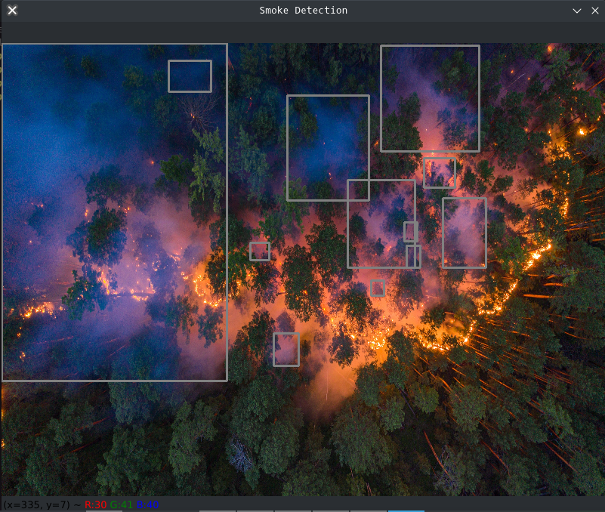
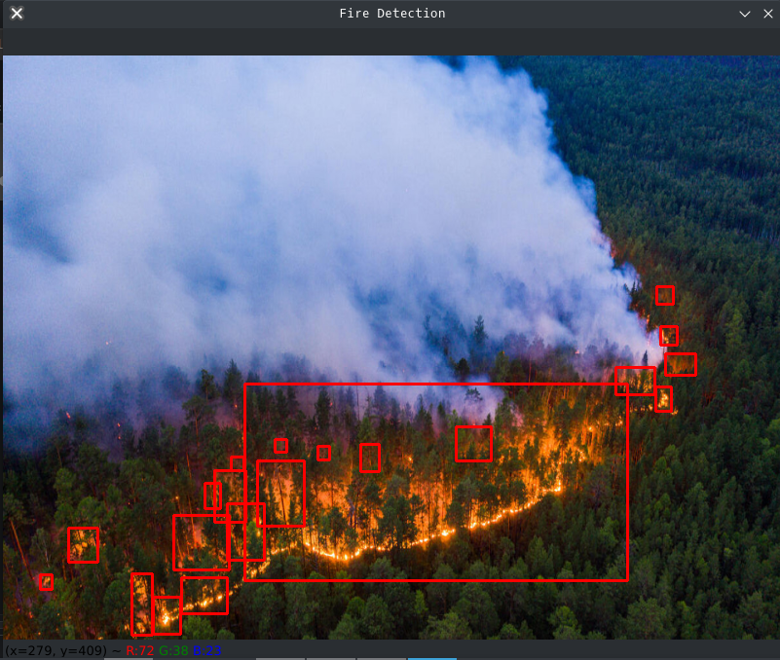
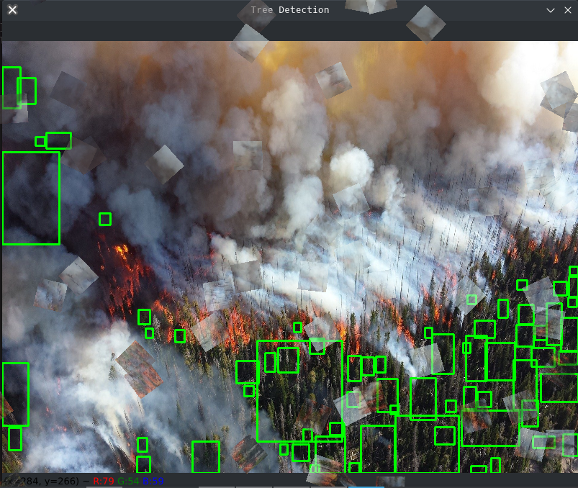
III. Technical Details
Demonstration of Bounding Boxes:

Slide 18
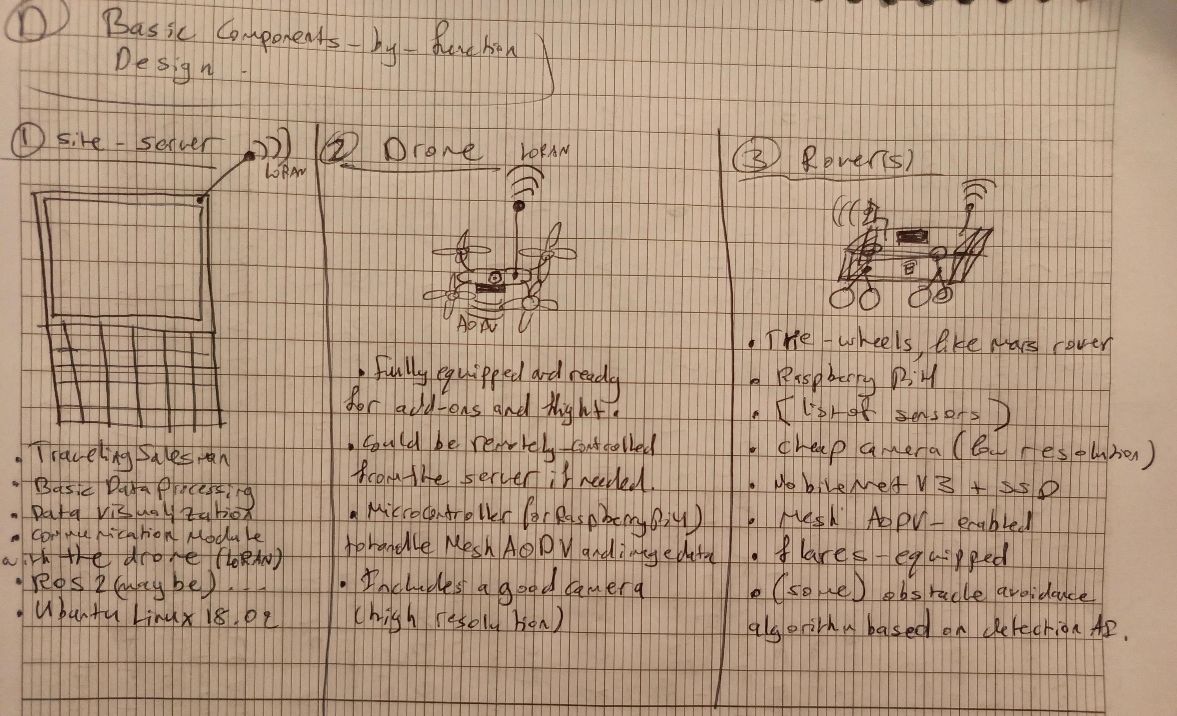
III. Technical Details
Decision Matrix: (include the excel sheet)
Preliminary Design:

Slide 19
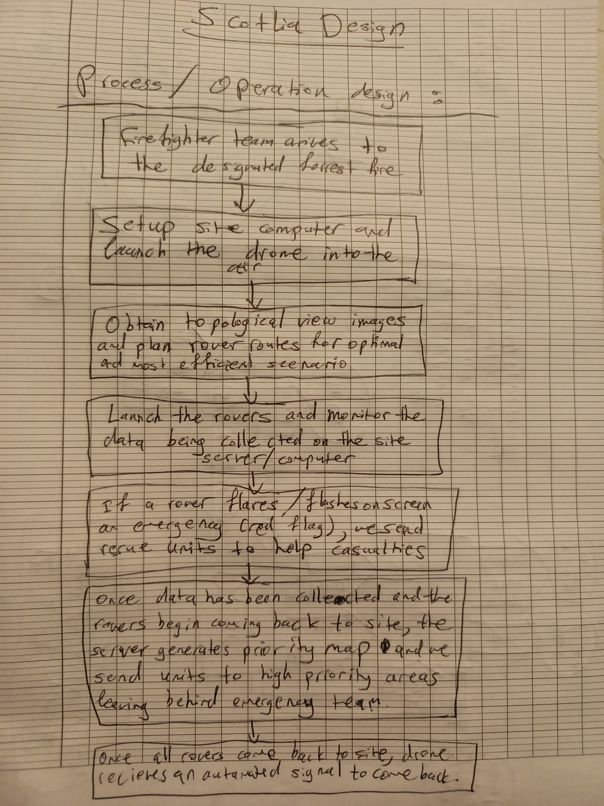
III. Technical Details
Preliminary Design:

Slide 20
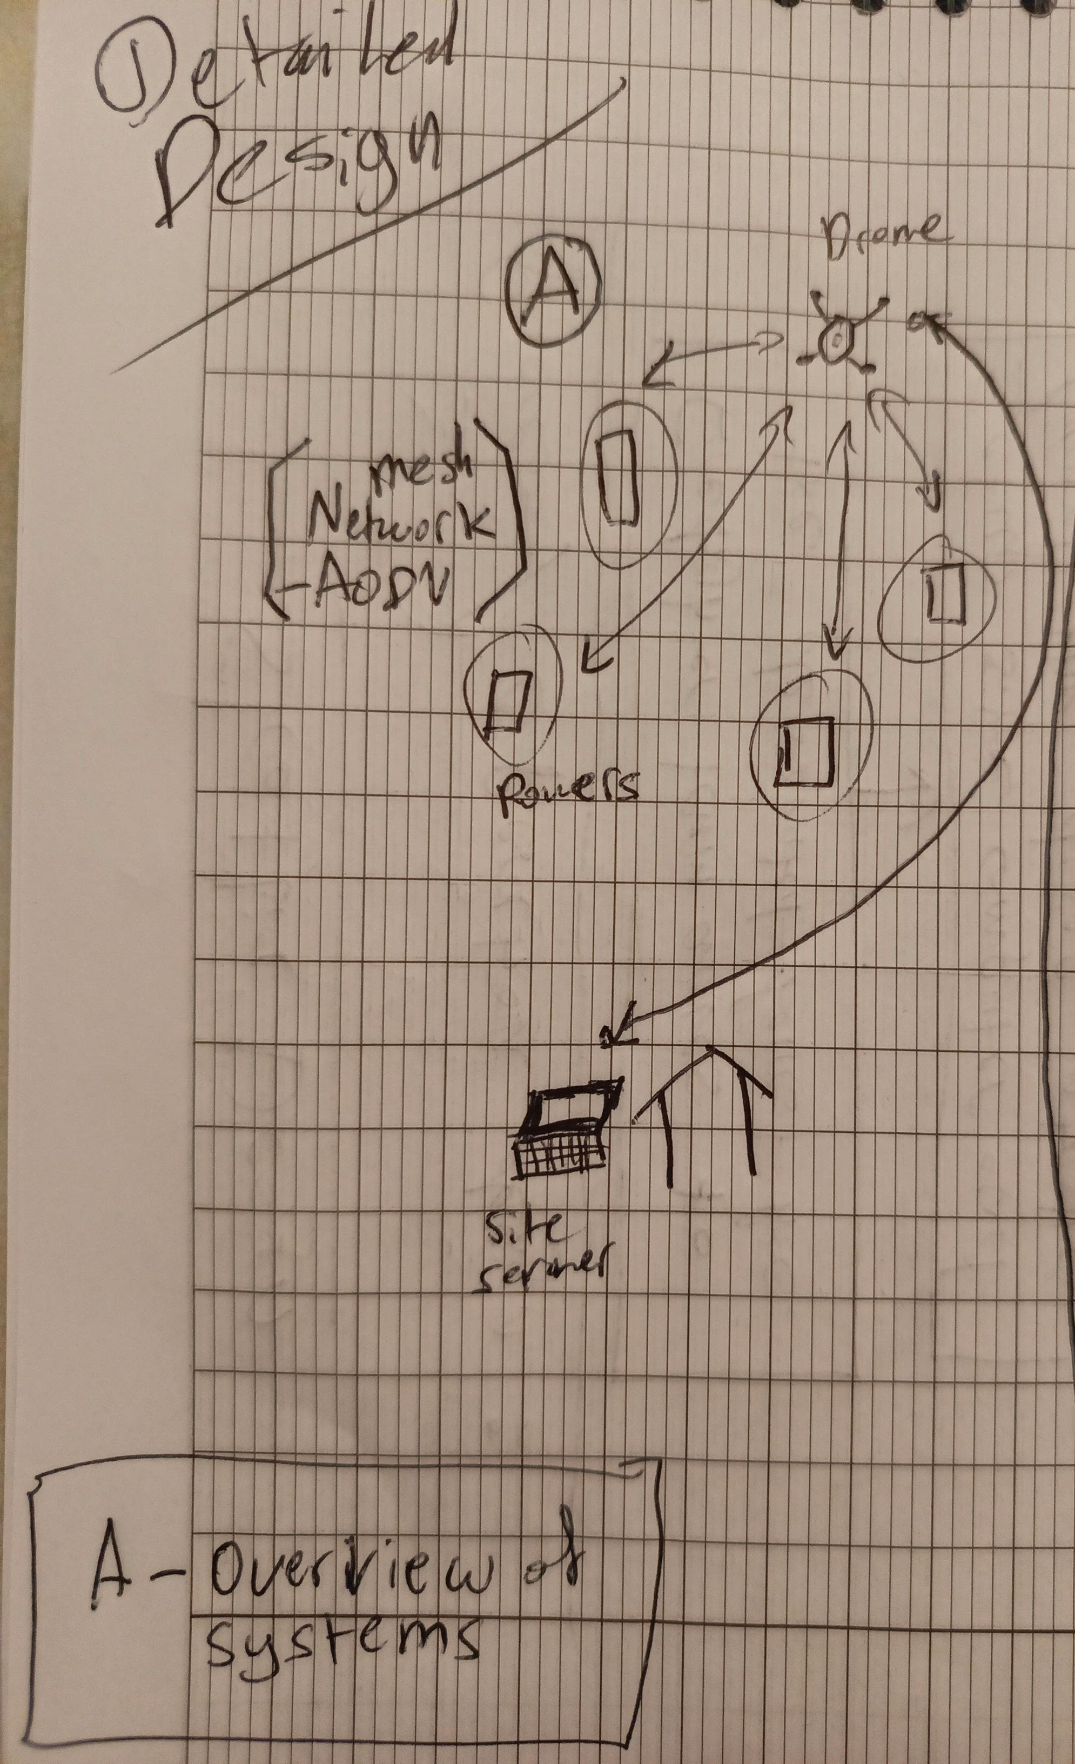
III. Technical Details
Preliminary Design:

Slide 21
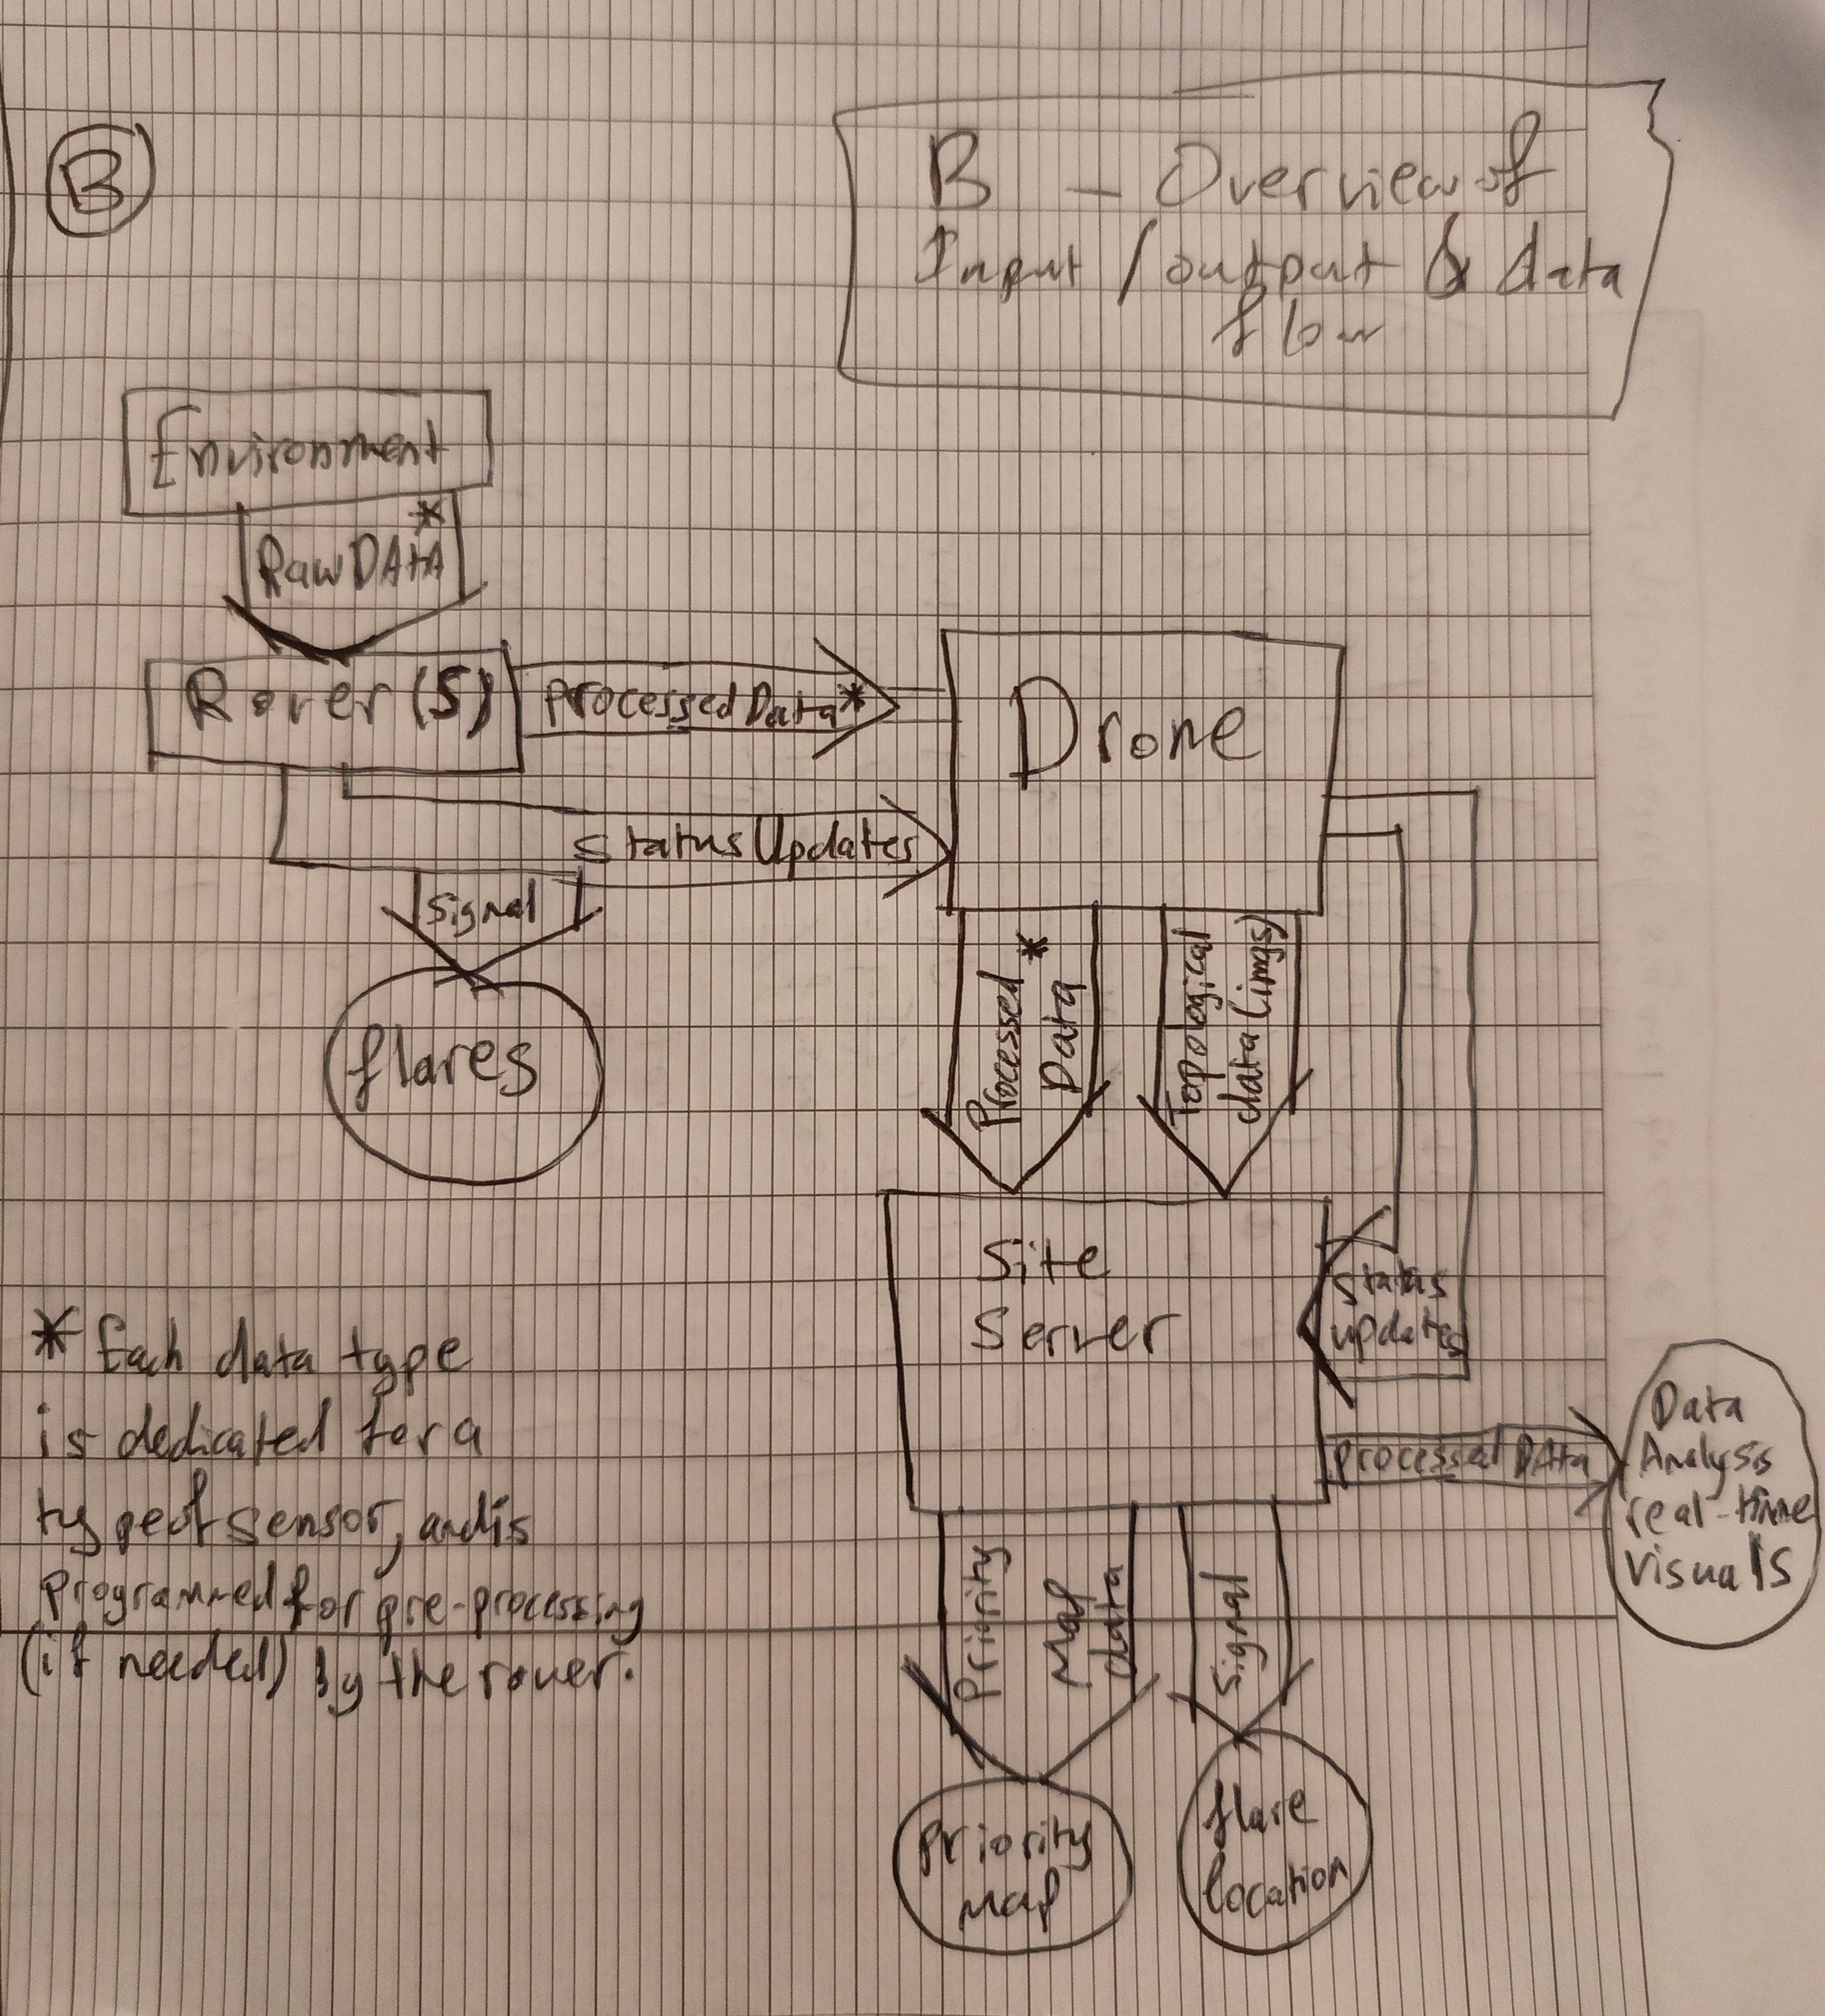
III. Technical Details
Preliminary Design:

Slide 22
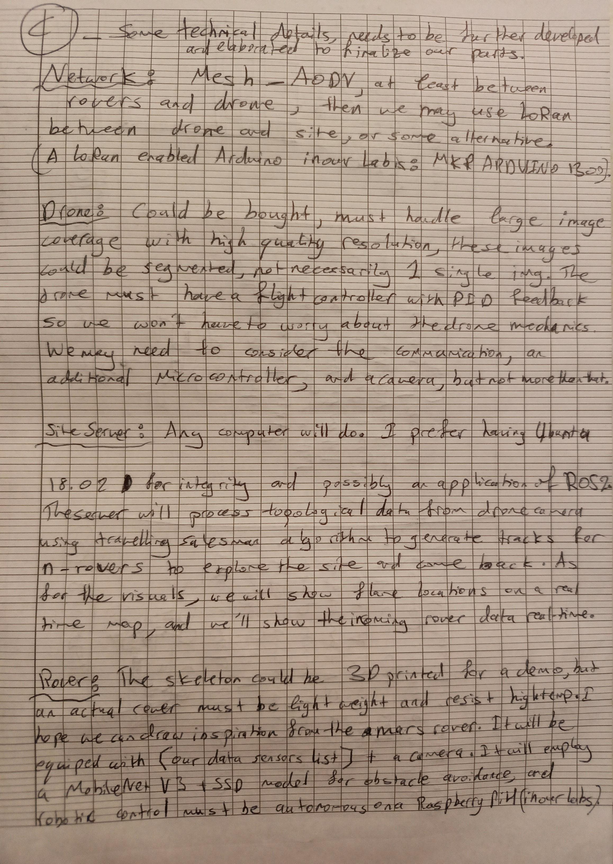
III. Technical Details
Preliminary Design:

